Slide 1
TREE DIAGRAMS

Slide 2
24
7
30
Date
Tree Diagrams
EQ – How can use a tree diagram to calculate probabilities?
9

Slide 3
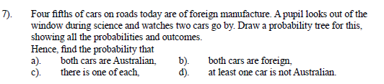
Revision

Slide 4
24
7
30
Date
Tree Diagrams
EQ – How can use a tree diagram to calculate probabilities?
What is probability without replacement?
In some experiments, the sample space (list of possible outcomes) may change for the different events.
The probability for each event will be different.
9

Slide 5
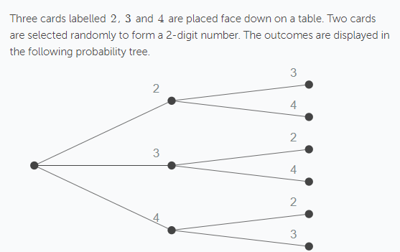
24
7
30
Date
Tree Diagrams
EQ – How can use a tree diagram to calculate probabilities?
Example
Since the cards are selected at the same time there is no replacement.
9

Slide 6
A bucket contains 4 blue marbles, 3 red marbles and 3 yellow marbles, two marbles are selected without replacement.
Draw the tree diagram and label the probabilities
P(BY)=
P(BB)=

Slide 7
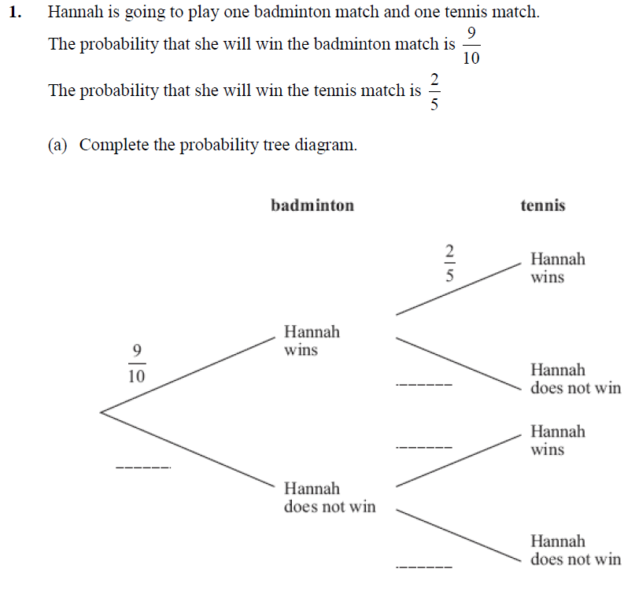

Slide 8
Worksheet

